Slide 1

Understanding the new AWEI
TELECONFERENCE CALLS
JULY 2013

Slide 2
Top 10 Submissions: Historic Overview

Slide 3
Three year cycle
AWEI, based on UK’s WEI is committed to a three year review
  Minor adjustments year-on-year (minor point shifts)
  Significant update every three years
  Difference between WEI, AWEI and HRC’s CEI
  First change to AWEI since it’s launch in 2010
    Local currency (reflect current local practice with room to move)
    Aligns with other global indexes (greater global benchmarking)
    Moves us closer to international best practice (higher expectations)
    Allows for greater planning over a longer period of time
    Eliminated some of the perceived duplication
  New Top 10 entry point - expectations
  Higher score value (200) : continuous benchmarking

Slide 4
AWEI Criteria Comparison
2010-2012 Index | 2013-2015 Index
Total points allocated: 100 | Total points allocated: 200
Announcements: Top 10 | Announcements: Top 20
Awards: Top 10 | Awards: Top 10
Section 1: Policy & Practice: 30 points | Section 1: Policy & Practice: 30 points
Section 2: Inclusive Culture & Employee Involvement : 40 points | Section 2: Culture & Visibility: 60 points
Section 3: Diversity Training: 10 points | Section 3: Staff Training & Development: 30 points
Section 4: Community Engagement: 10 points | Section 4: Monitoring: 10 points
Section 5: Additional Work: 5 points | Section 5: Supplier Policies (15 points)
Section 6: Optional AWEI Survey: 5 points | Section 6: Community Engagement (30 points)
 | Section 7: Inclusion Beyond : 10 points
 | Section 8: Additional Work: 10 points
 | Section 9: Optional AWEI Survey : 5 points

Slide 5
Section Analysis
Section | Changes
Section 1: Policy & Practice | Still worth 30 points covering the fundamental basics of policy and practice with the accommodation of both pillared and blended approaches to strategy formulation and strategic/network/joint accountabilities against targets Stretch targets include: monitoring of LGBTI related complaints with action; communication with EAP programs;
Section 2: Culture & Visibility | Name changed from Inclusive Culture & Employee Involvement to better reflect content Increase from 40 to 60 points Stretch targets include: network member feedback; network engagement in AWEI submission; collaboration with other internal networks; promotion of out role models; sustainability plans; visibility of inclusion initiatives Accommodates multiple executive sponsors New subsection for CEO (or equivalent) involvement/support New subsection for Ally Engagement
Section 3: Staff Training & Development | Name change from Diversity Training to better reflect content Increase from 10 to 30 points Content checklist for training (can add to; greater flexibility) Stretch targets: Managers/Leaders: nomination of champions; senior manager accountability; reverse mentoring programs; app0intment criteria New subsection: Career development: LGBTI specific opportunities / talent progression

Slide 6
Section Analysis
Section 4: Monitoring
Section 4: Monitoring | New Subsection : 10 points Collection of LGBTI related data Analysis of LGBTI related data
Section 5: Supplier Policies | New Subsection : 15 points Diversity compliance expectations
Section 6: Community Engagement | Increase from 10 to 30 points Stretch targets: LGBTI media; mainstream media; New Subsection : Commercial / Public Service / Higher Ed related engagement
Section 7: Inclusion Beyond | New section: 10 points Impact beyond the walls of your employee base Incorporates: mentoring of other organisations, providing awareness to audiences beyond employee base, innovative products or initiatives
Section 8: Additional Work | Increase from 5 to 10 points Between 1-2 points allocated per valid nomination
Section 9: AWEI Survey | 2 points participation Additional 3 points: invitation out to entire group (and evidence in submission numbers)
Throughout | Questions around sustainability

Slide 7
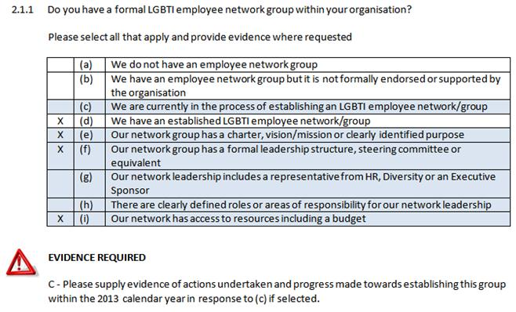
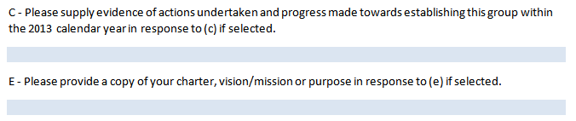
New look submission

Slide 8
New Awards
New Awards
Regional/Rural branch/office (under small business awards)
Innovation Award
CEO of the Year Award (CEO or equivalent)
Executive Leadership Award
Changes
Role restriction removed from Diversity Champion Award
Currently being investigated
Ability to submit online (will have a choice)
  Tracks previous submissions, allows for copying data over

